Slide 1
Welkom bij de aryakaEvent
8 mei 2017

Slide 2



aryakaEvent
“Connectiviteit met China”

Slide 3

Programma wordt verzorgd door…..
BRADON – puts IT through!
1421 Consulting Group – Compliance in China
ARYAKA – SmartConnect at-a-glance
Een live casus van

Slide 4
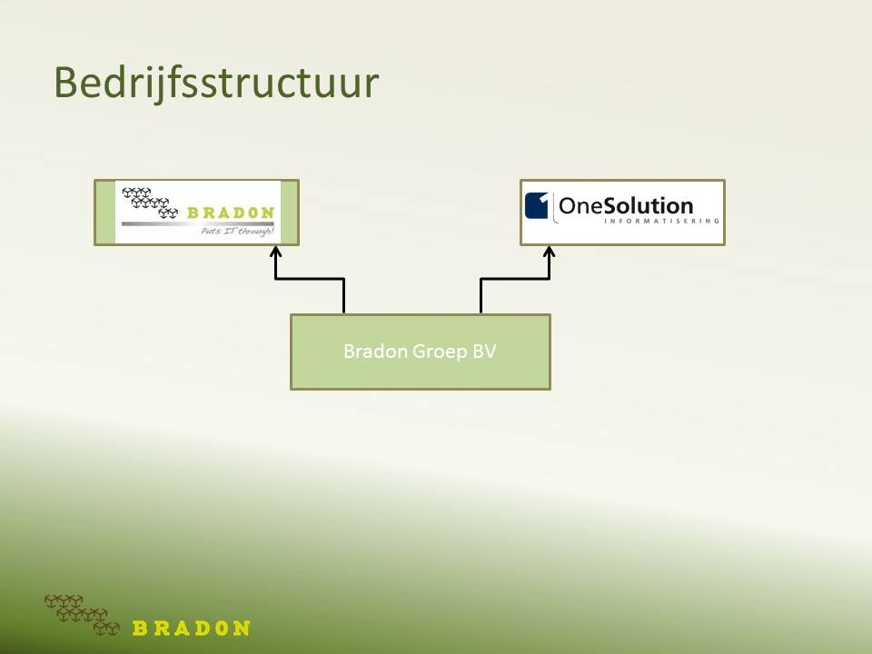
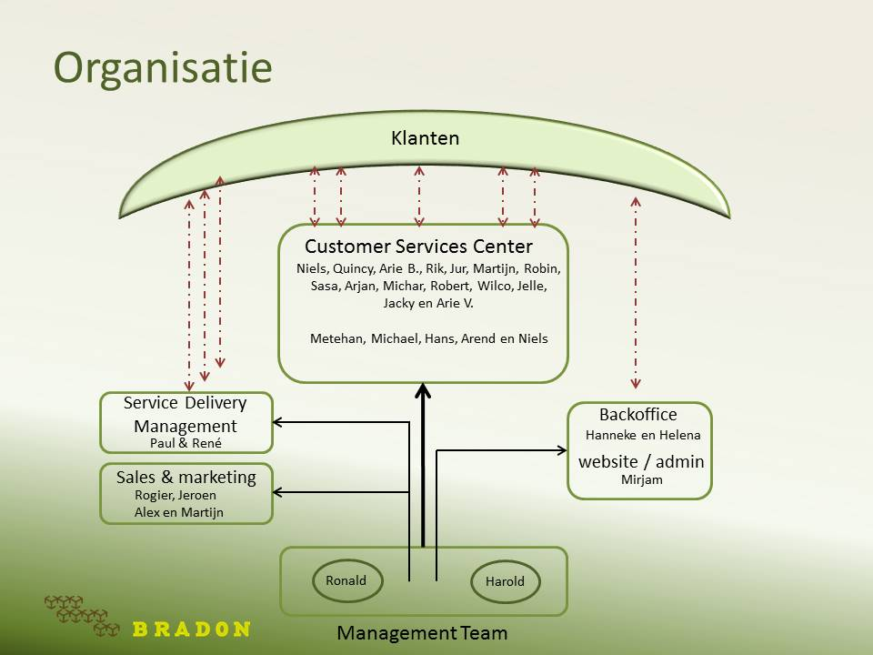
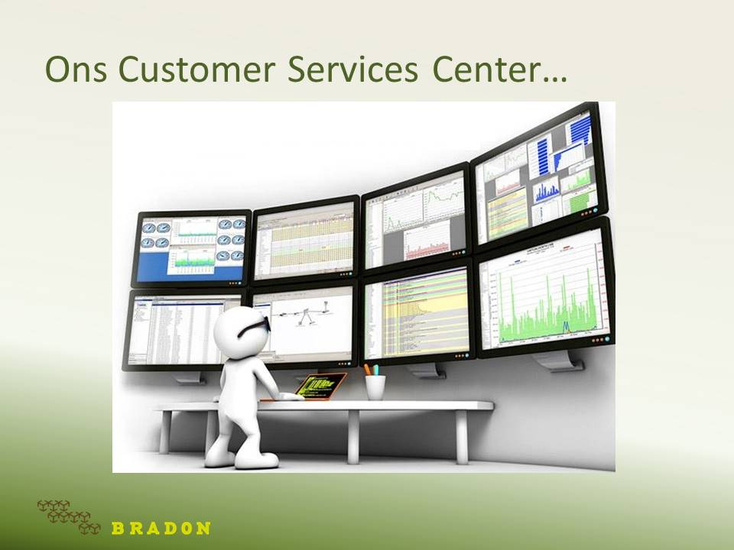
Bradon – put IT through!
Apeldoorn

Slide 5
Cloud computing - een stukje geschiedenis
In 1996 – eerste initiatieven
2006
“ASP”
Marktleiders adopteren Cloud computing
Cloud computing
Middels een Browser een applicatie gebruiken
Hoe staat het met het Netwerk?
Software/Systemen
2016 – volwassen markt
Cloud computing met vernieuwede concepten
IaaS
BaaS
SaaS
PaaS
Software/Systemen

Slide 6

Ons dienstenportfolio…

Slide 7

Ons ultieme doel…
Echter, ondernemen met CHINA vraagt om meer dan een goede
ICT-huishouding!
U te “ontzorgen”

Slide 8


Connectivity with China - Staying Chinable;
The Importance of Compliance

Slide 9



Slide 10


Slide 11

Notes:
This slide isn't designed to be shown for more than a few seconds.

Slide 12

Notes:
Business Consulting Services
Corporate Services
Accounting Services
Management Services
Optimization Services
HR Services

Slide 13
Why is compliance difficult?

Slide 14
Knowing everything is difficult
What is the business scope of your WFOE/JV?
Do you know the regulatory landscape of your industry for the upcoming 5 years?
Do you speak & read Chinese?
Did you ever insult your employees when being strict on certain matters?
Notes:
Example of operating outside a business scope: Fine of one month!
Fast changing regulatory landscape can cause problems. One day it is legal, the next it is not.
Examples: Revised Food Safety Law, Ride Hauling regulations.
How can you know changes in regulations if you do not speak the language?
Import/Export declaration fined
Next slide external factors

Slide 15
External factors

Slide 16
Government increasing scrutiny on
Corruption
Pricing
Tax compliance
Foreign company structures
Notes:
Example of the car industry

Slide 17
The oyster called China
Guarding Chinese companies in sectors
Targeting foreign luck seekers
Three main industries
Notes:
Example of the wind industry

Slide 18
Internal factors

Slide 19
Language
Always dependent on hearsay regarding:
Contractual content
(Changes in) rules & regulations
Agreements
Notes:
Not being able to read contracts due to language, this provides the problem of not knowing what has been agreed upon. This might cause that you operate outside your business scope.
Changes in rules & regulations will only come to you when a Chinese tells you out of their own movement. Seeing you can’t speak the language it is impossible to follow these changes yourself Car hailing rules of a fast changed rule

Slide 20
Intercultural communication
Difficult to hear a hard; no!
Accidental insults can be retaliated
Agreements
Notes:
When an western entrepreneur asks a direct question about the legal possiblities, the answer could be;
it is no problem. This could mean they would be operating in the grey.
With the increased scrutiny by the Chinese government this provides problems in the future
- The example of “forgetting” taxfilling after an argument over a declaration. The relationship was not managed properly

Slide 21
So how can you stay “Chinable”

Slide 22
Staying “Chinable”
Work on the relationship
Make sure your staff provide you with information on ever-changing rules & regulations
Understand culture & habit differences
Regularly (every 3-5 years) have an external company check your WOFE/JV structure against the rules & regulations in place
Notes:
Spending lunches together, asking about family, bring small gifts from Europe
Use the relationship to get a reliable stream of information. However ask directly for such a stream of information!
Get to understand the culture and habit differences so you do not accidently insult your employee/tax adviser, etc.
Check your company structure through any organisation, not does not have to be us.

Slide 23
Chinable Business Scan (CBS)
Notes:
Explain the CBS!

Slide 24
CBS
“Checking whether your organization is still compliant to current legal and financial standards, while having a critical look at operational efficiency.”

Slide 25
CBS Content
Legal & Administration
Organisation & Human Resources
Finance & Accounting
Sales & Marketing
Supply Chain

Slide 26



Any questions about compliance?
Contact Us
www.1421.consulting
michaelpronk@1421.consulting
Join the Conversation @
@Beijing1421
@1421consulting
@1421 Consulting Group

Slide 27
Aryaka – SmartConnect at-a-glance
Dhr. Hein Pattyn – Sales Director EMEA

Slide 28


The Worlds #1 MPLS Replacement Technology
Aryaka global sd-wan
Fast
Reliable
Scalable
connectivity for the global enterprise
CONNECT. ACCELERATE. SCALE.
Global – Private Network Based - SD-WAN
www.Aryaka.com
Jason Wells | Managing Director EMEA

Slide 29





















ANY APPLICATION, ANYWHERE IN THE WORLD
FAST PERFORMANCE
CONSISTENT USER EXPERIENCE
RAPID DELIVERY
©2017 Aryaka Confidential and Proprietary. Do not reproduce or distribute without prior permission.
Notes:
Requirement in today’s businesses is fast performance, consistent user experience, anywhere in the world. And can be deployed within a couple days.
Mission-critical apps – ERP, CRM,
Business-critical – WebEx, CRM, etc.
Slowdowns is lost productivity and lost revenue, lost business execution

Slide 30
Corporate facts
In Operation
Since
2007
Headquarters
Silicon Valley (San Francisco Bay Area)
550+
GLOBAL
CUSTOMERS
5 OFFICES
ACROSS
3 GEOS
$50M+
ANNUAL
REVENUES
©2017 Aryaka Confidential and Proprietary. Do not reproduce or distribute without prior permission.

Slide 31























Trusted by big Brands– 98% Retention
©2017 Aryaka Confidential and Proprietary. Do not reproduce or distribute without prior permission.

Slide 32








KEY TRENDS THAT ARE TRANSFORMING IT
Cloud Computing
Globalization
Mission critical Enterprise apps are moving to the Cloud
Organizations are increasingly going global
Mobility
Legacy
Networks
Increasingly mobile workforce
MPLS / Internet ill-equipped to support this new paradigm
Virtualization
Data center density / virtualization taxing the network
©2017 Aryaka Confidential and Proprietary. Do not reproduce or distribute without prior permission.

Slide 33











Happening in enterprises – Now!
PARTNERS
HQ
MPLS
P2P
IP-VPN
CDN
CUSTOMERS
INTERNET
PUBLIC USERS
INTERNET
Cloud Services/SaaS
O365/Azure/AWS
TRAVELING/SOHO USERS
©2017 Aryaka Confidential and Proprietary. Do not reproduce or distribute without prior permission.

Slide 34

LEGACY APPLICATION MODEL
Branch
Office
Branch
Office
MPLS
Branch
Office
Datacenter/HQ
App
App
IP-VPN
App
App
MPLS
Branch
Office
Branch
Office
Branch
Office
©2017 Aryaka Confidential and Proprietary. Do not reproduce or distribute without prior permission.

Slide 35



TODAYS APPLICATION MODEL
Remote User
Branch
Office
App
Branch
Office
MPLS
Branch
Office
App
App
Datacenter/HQ
App
AWS
IP-VPN
App
App
MPLS
Branch
Office
Branch
Office
App
Azure
Branch
Office
Remote User
Remote User
©2017 Aryaka Confidential and Proprietary. Do not reproduce or distribute without prior permission.

Slide 36











The only GLOBAL SD-wAN built on a Private WAN
Amsterdam
London (2x)
Frankfurt
San Jose
Chicago
Tel Aviv
Beijing
Seoul
Los Angeles
Ashburn
Tokyo
Dallas
Dubai
Shanghai
Miami
Delhi
Taiwan
Mumbai
Hong Kong
Bangalore
Chennai
Singapore
Redundant / Resilient
  Tier 1 Multi-carrier / Multi-link per POP
Real-time Agility
  Locations in hours / days
  Bandwidth bursting on-demand
  Universal Acceleration / Optimisation
Sao Paulo
Johannesburg
Sydney
©2017 Aryaka Confidential and Proprietary. Do not reproduce or distribute without prior permission.

Slide 37
Cloud Application Ready
Amsterdam
London (2x)
Frankfurt
San Jose
Chicago
Tel Aviv
Beijing
Seoul
Los Angeles
Ashburn
Tokyo
Dallas
Dubai
Shanghai
Miami
Delhi
Taiwan
Mumbai
Hong Kong
Bangalore
Chennai
Singapore
Example SaaS App’s
Aryaka
Amazon Web Services
Google Apps
Rackspace
Terremark
Office 365
SalesForce
NetSuite
Microsoft Azure
Sao Paulo
Johannesburg
Sydney
©2017 Aryaka Confidential and Proprietary. Do not reproduce or distribute without prior permission.

Slide 38
SMART, Software-defined
GLOBAL network platform
SMART CONNECT
SMART CDN
SMART MOBILITY
FULLY MANAGED SERVICE
CENTRALIZED MANAGEMENT & MONITORING
MULTI-LAYER SECURITY
OPTIMISATION
APPLICATION ACCELERATION
EDGE INTELLIGENCE
GLOBAL PRIVATE NETWORK
ARYAKA SMART SOFTWARE DEFINED NETWORK PLATFORM
©2017 Aryaka Confidential and Proprietary. Do not reproduce or distribute without prior permission.

Slide 39

Embedded, Unmatched Application performance & agility
DYNAMIC ACCELERATION
CACHING & COMPRESSION
APPLICATION PROXIES
DATA DE-DUPLICATION
TCP OPTIMISATION
QOS & SECURITY
FULL MESHED CONNECTIVITY
INTEGRATED VISIBILITY
GLOBAL REDUNDANCY
©2017 Aryaka Confidential and Proprietary. Do not reproduce or distribute without prior permission.

Slide 40


Patented - Multi-segment architecture
Aryaka
Origin POP
Aryaka
Destination POP
DC / HQ
Branch Office
Multi-Segment-Optimisation
Link Redundancy
IPSec Security
TCP Optimisation
Deduplication
Compression
QoS
Private Network
Low, Stable Latency Core
TCP Optimisation
Intelligent routing
IPSec Security
Application proxies
QoS
Link Redundancy
IPSec Security
TCP Optimisation
Deduplication
Compression
QoS
FIRST MILE
MIDDLE MILE
LAST MILE
©2017 Aryaka Confidential and Proprietary. Do not reproduce or distribute without prior permission.

Slide 41
Consuming our services
1 to 5 Day Set-up Options
Each site requires a regular Internet connection (DIA)
ANAP shipped to & installed at site
Embedded WAN Optimisation edge-to-edge
©2017 Aryaka Confidential and Proprietary. Do not reproduce or distribute without prior permission.

Slide 42
What We Do
  The Only SD WAN Delivered Over A Private WAN
©2017 Aryaka Confidential and Proprietary. Do not reproduce or distribute without prior permission.

Slide 43

Any Questions ?
Next Steps & Moving Forwards
©2017 Aryaka Confidential and Proprietary. Do not reproduce or distribute without prior permission.

Slide 44
Een live casus
Sinds 2013 heeft Xindao een MPLS Wanverbinding van 4mb. Deze datalijn heeft eigenlijk nooit gepresteerd als werd opgegeven. Belangrijkste beoordeling criteria : pricing, betrouwbaarheid en snelheid.
Bij Xindao speelt een centralisatie vraagstuk waarbij, via Citrix, het merendeel van het kantoor in Shanghai via ons Hoofdkantoor in Rijswijk wordt gehost. Dan spelen genoemde criteria een belangrijke rol.
Medio 2016 werd Xindao door Bradon geattendeerd op een nieuwe dienst in dit segment, een dienst die Bradon samen met Aryaka heeft opgezet en die gelanceerd moet worden op het Europese continent. De dienst is gebaseerd op een aantal technische hoogstandjes en komt er op neer dat d.m.v. compressie en data accelerator technieken de bandbreedte dermate wordt uitgenut dat resultaten zijn te verwachten die superieur zijn aan de bestaande dienstverlening. Dit zou uitstekend passen bij onze overweging Shanghai te centraliseren, snelheid en betrouwbaarheid zijn dan immers een must. Ook belangrijk was dat de pricing in het kader van “waar voor je geld” gunstig te noemen is waarbij de interesse bij Xindao alleen maar toenam.
In pilotvorm is deze dienst vervolgens opgezet en vergeleken met de prestaties van de oude datalijn (als benchmark). De resultaten waren zeer goed te noemen. Verschillende identieke testruns laten zien dat de snelheid t.o.v. de benchmark met een factor 4 tot 5 is toegenomen.
De latency is zeer stabiel te noemen, de betrouwbaarheid is oké maar een echt oordeel kan pas worden bepaald als deze dienst, die sinds september 2016 live is gegaan, een jaar heeft gedraaid.
Tot slot kent deze dienst een behoorlijke flexibiliteit: Er kan zeer snel en op maat periodiek een hogere bandbreedte worden afgenomen en dat is voor Xindao interessant bij bijvoorbeeld migraties of grote data volumes.
Gerard van Dien - Manager ICT Infrastructure and Operations

